Slide 1

DIGITAL TWIN & FLEET MONITORING DASHBOARD
Joseph Diggins - FYP

Slide 2
Introduction
A Digital Twin System
A User-Friendly Monitoring Dashboard
Real-Time Monitoring
Research Question:
"Does the implementation of Digital Twin technology, coupled with a fleet monitoring dashboard, contribute to enhancing the visual clarity and overall user experience in crane system monitoring?"

Slide 3
Importance to Liebherr
Elevate Crane Performance.
Pioneer Advancements in Predictive Maintenance.
Improve Efficiency.
Adaptability to Industry Changes.
Enhanced Operational Insight.

Slide 4
Objectives and Expected Outcomes
Objectives:
This project aims to improve the current system through the integration of Digital Twin technology.
Transform the monitoring and optimisation of STS cranes by creating a virtual mirror of real-world crane operations.
Provide a platform for real-time monitoring dashboard for STS cranes
Design an intuitive dashboard interface.
Expected Outcomes:
User Friendly Monitoring.
An extendable and scalable platform.

Slide 5
Approach and Methodology
Phased development process.
Basic Prototype using Unity
Incremental Integration of Historical Data.
Monitoring Dashboard Creation using Photoshop.
Power BI Integration.
Ensure Scalability.

Slide 6
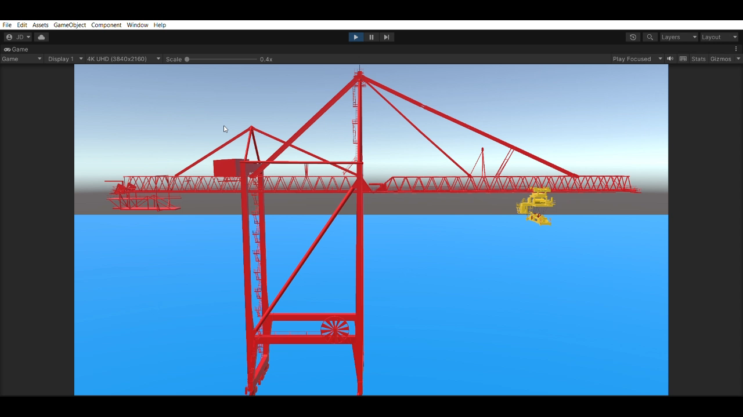
Live Demo

Slide 7

Questions

